Slide 1
RocksDB Festival
Supported by IITP, StarLab.
August 2, 2021
송인호, 한예진
inhoinno@dankook.ac.kr , hbb97225@naver.com
TeamName : 멘탈모델을 만들고 싶어요

Slide 2
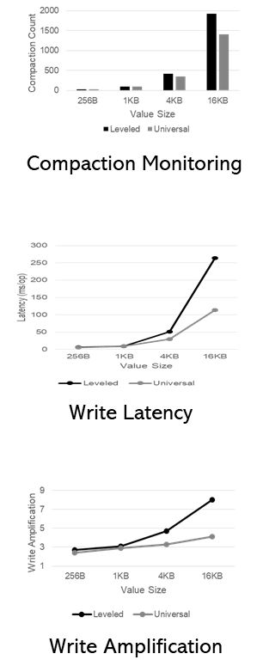
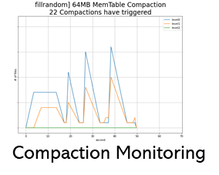
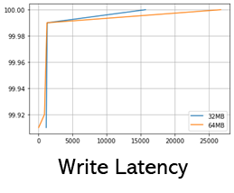
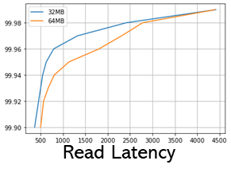
Contents
Last Week
Leveled vs Universal Compaction Comparison
meeting feedback 정리
KSC 논문 그림 실험 재현
Read Amplification
This Week
관련 논문 조사
Compaction 코드 리뷰
KSC 논문 작성
2

Slide 3
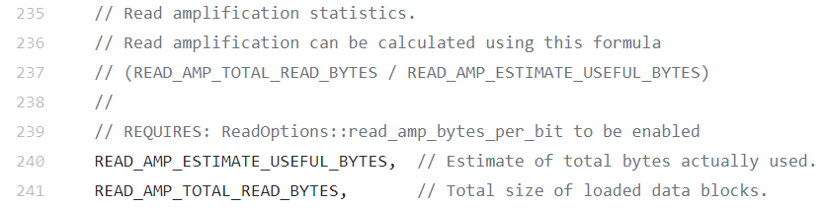

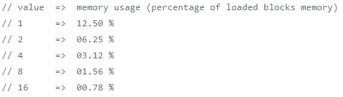


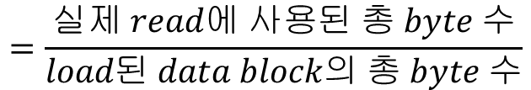

Read Amplification
How to estimate Read Amplification Factor?
$$RA$$
$$=\frac{READ_AMP_TOTAL_READ_BYTES}{READ_AMP_ESTIMATE_USEFUL_BYTES}$$
$$=\frac{실제 read에 사용된 총 byte 수}{load된 data block의 총 byte 수}$$
include/rocksdb/statistics.h
include/rocksdb/table.h

Slide 4
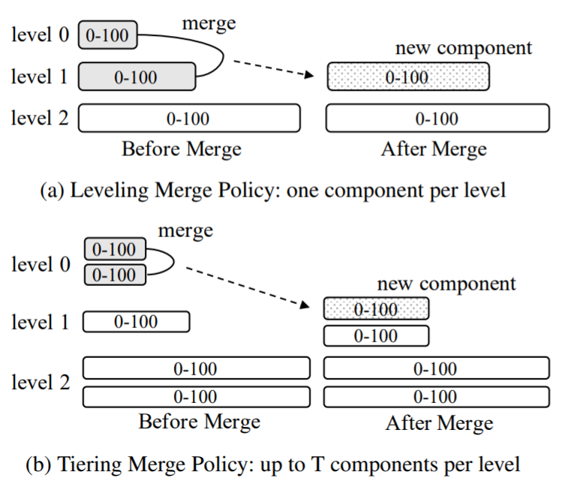

LVL vs Univ Read Amplification
Level Compaction
Tiered Compaction
($≠RocksDB Universal Compaction$)
Readrandom
No difference…. (→ Due to Bloom filter)
Range query
Big difference !!!

Slide 5
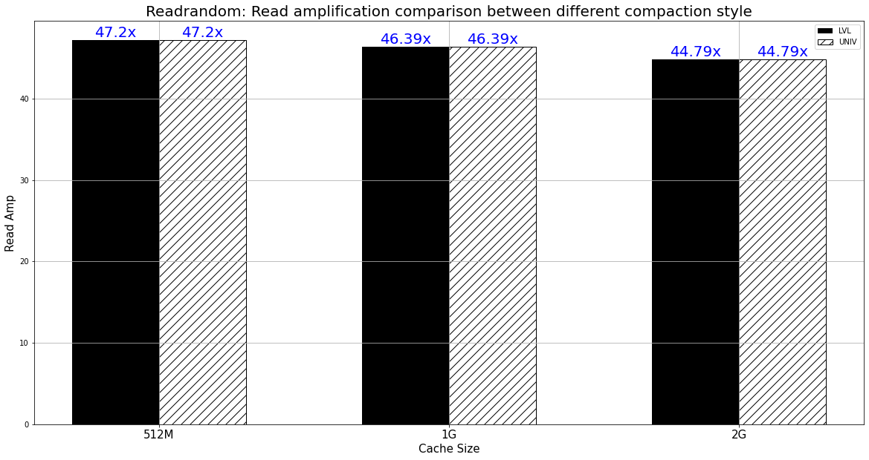
LVL vs Univ Read Amflification: Readrandom
Readrandom result :: Read amplification
(K16, V64 readrandom, ~10GB)
☞ Bloom filters are useful for single-key lookups (“Is key 42 in SSTable?”)
☞ No difference between LVL and Univ compaction style.

Slide 6
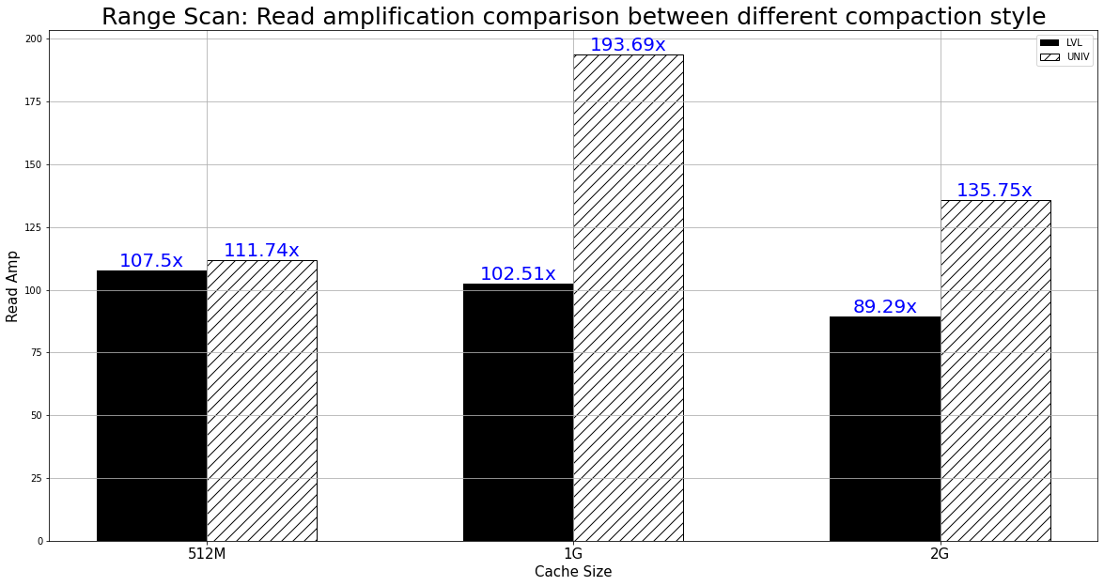
LVL vs Univ Read Amplification: Rangequery
Range scan result :: Read amplification
(K16, V64, seek random, ~10GB)
☞ Bloom filters cannot handle range queries
(“Are there keys between 42 and 1000 in the SSTable?”)
☞ Big difference between LVL and Univ compaction style

Slide 7
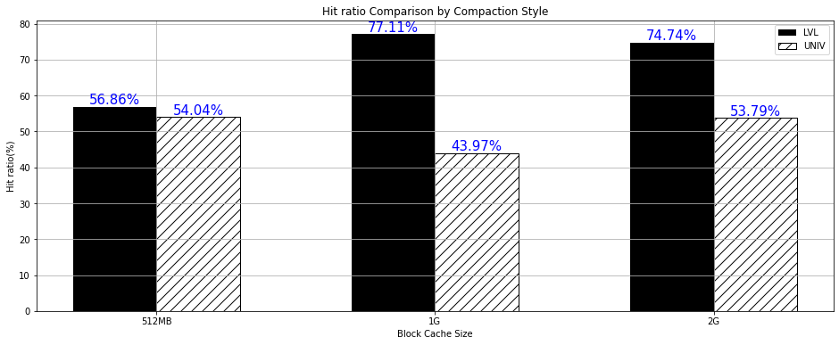
LVL vs Univ Read Amplification: Rangequery
Range scan result :: Hit ratio
(K16, V64, seek random, ~10GB)
☞ Bloom filters cannot handle range queries
(“Are there keys between 42 and 1000 in the SSTable?”)
☞ Big difference between LVL and Univ compaction style

Slide 8
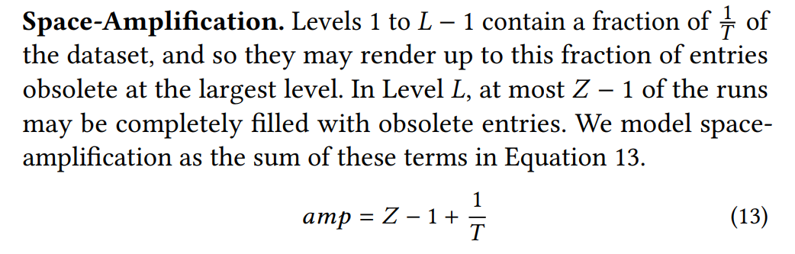
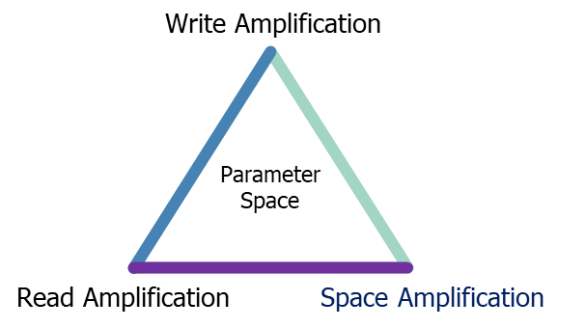
LVL vs Univ Space Amplification
How to estimate Read Amplification Factor?
Niv Dayan, Stratos Idreos, Dostoevsky: BetterSpace-Time Trade-Offs for LSM-Tree Based Key-Value Stores via Adaptive Removal of Superfluous Merging, SIGMOD ‘18

Slide 9

Discussion

